Slide 1
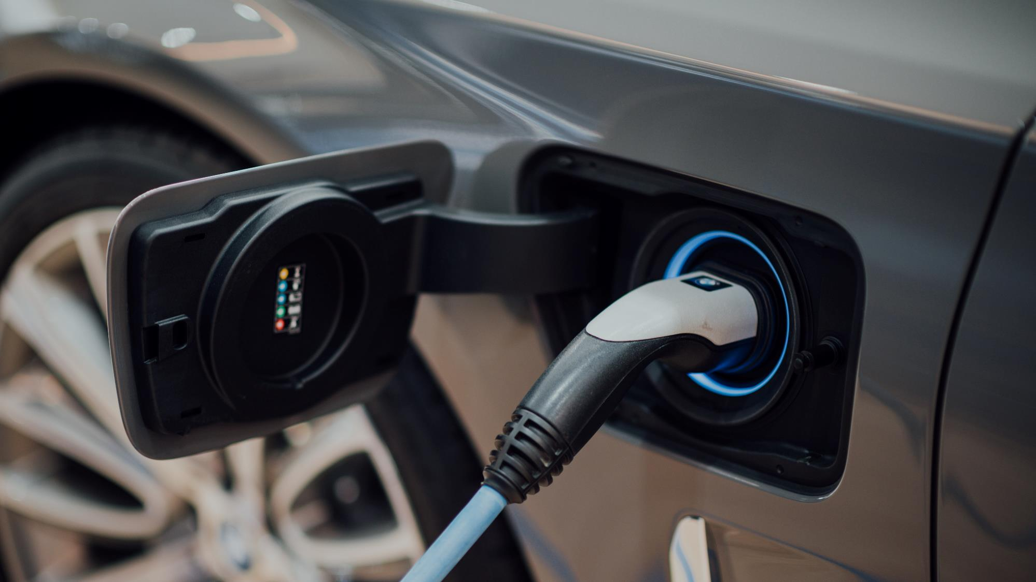

Capstone Design

Slide 2
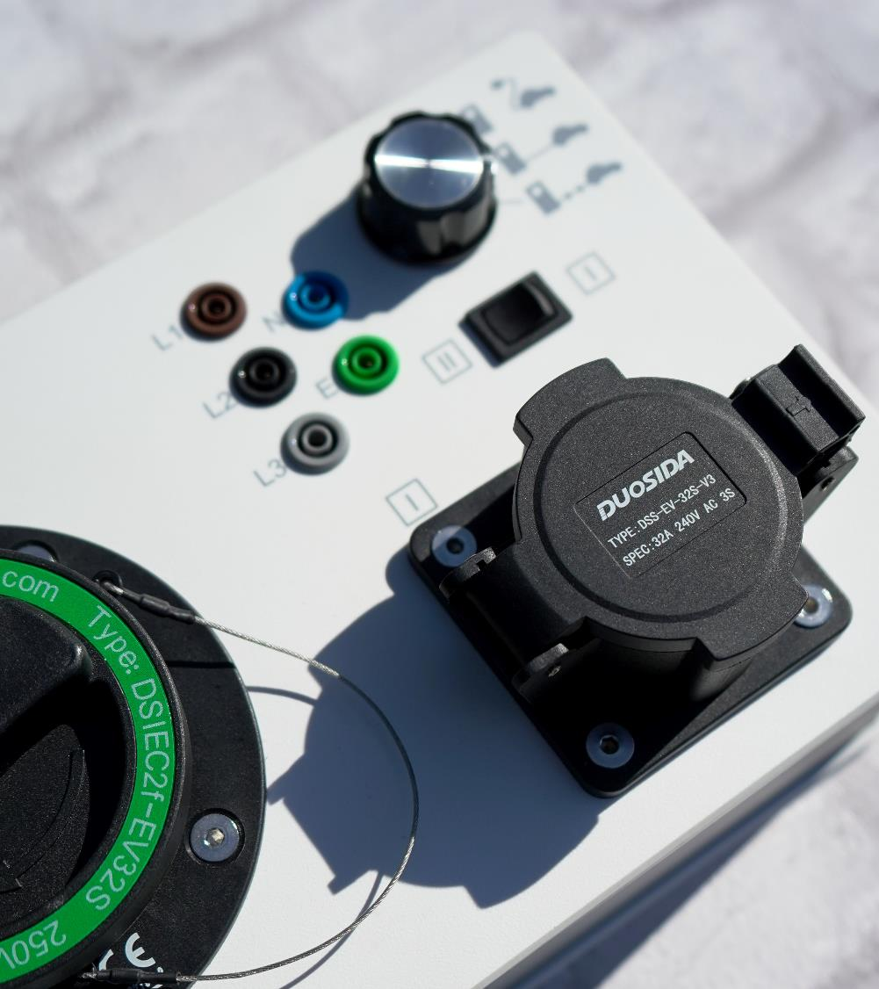
목차
contents
1
Allied Vision Camera
2
Camera Calibration
3
Depth Image

Slide 3
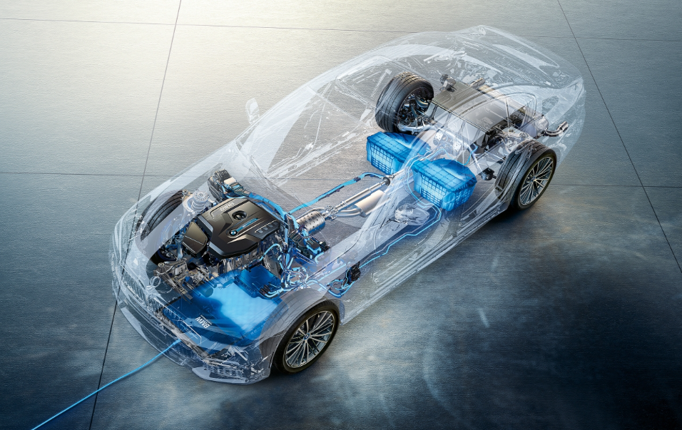
Part 1,
Allied Vision Camera

Slide 4

Part 1
Allied Vision Camera
Left
Focus Length : 6mm
Center
Focus Length : 3.5mm
Right
Focus Length : 6mm

Slide 5
Part 1
Allied Vision Camera
Camara _Matrix
Mono_Camera.launch
Stereo Camera.launch
Source : https://github.com/astuff/avt_vimba_camera/blob/ros1_master

Slide 6
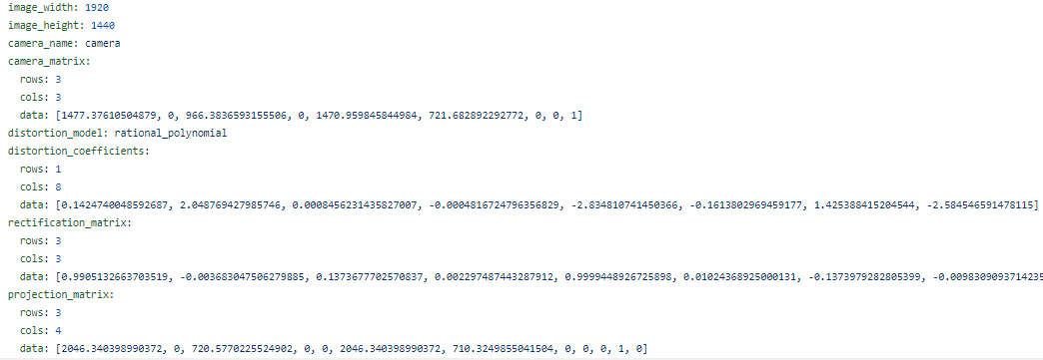
Part 1
Allied Vision Camera
Camara _Matrix

Slide 7

Part 2,
Camera Calibration
Same Focus
Different Focus

Slide 8

Part 2
Same Camera Calibration
Left : 42
Right : 42
Test : 4

Slide 9
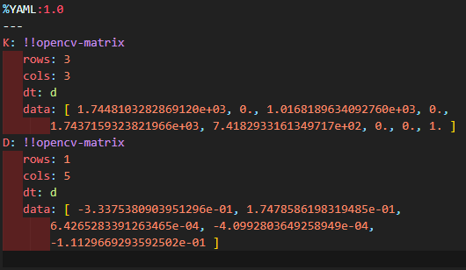

Part 2
대회
Part 2
Same Camera Calibration
Left Camera Matrix

Slide 10
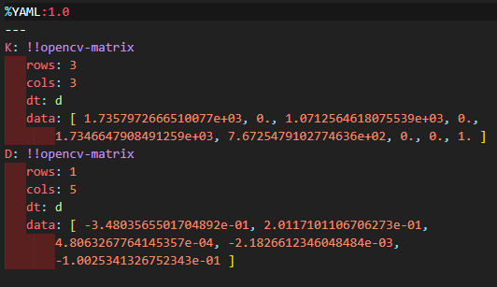
Part 2
대회
Part 2
Same Camera Calibration
Right Camera Matrix

Slide 11
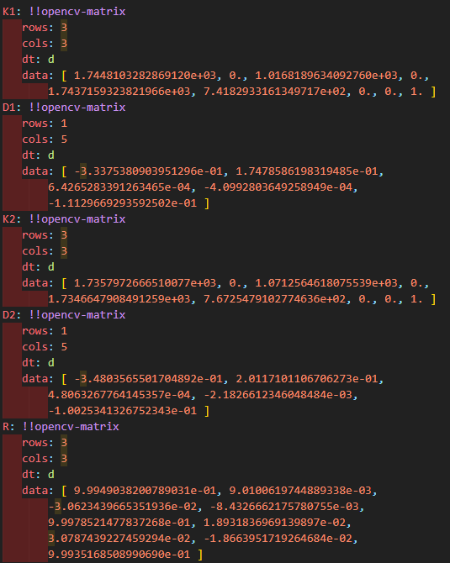
Part 2
대회
Part 2
Same Camera Calibration
Stereo Camera Matrix

Slide 12
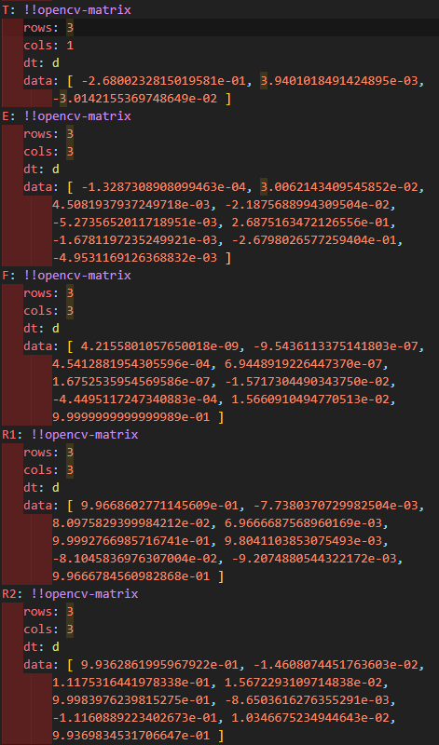
Part 2
대회
Part 2
Same Camera Calibration
Stereo Camera Matrix

Slide 13
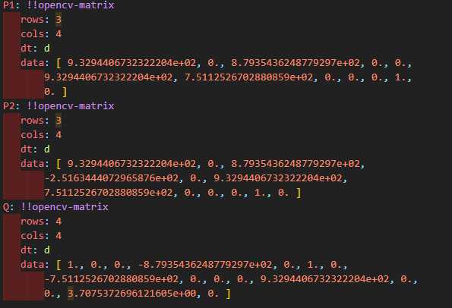
Part 2
대회
Part 2
Same Camera Calibration
Stereo Camera Matrix

Slide 14

Part 3,
Depth Image

Slide 15
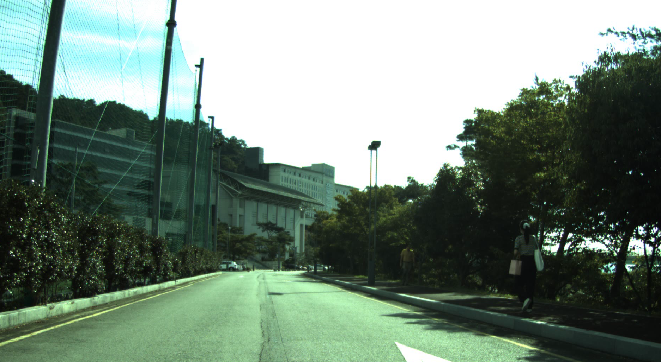
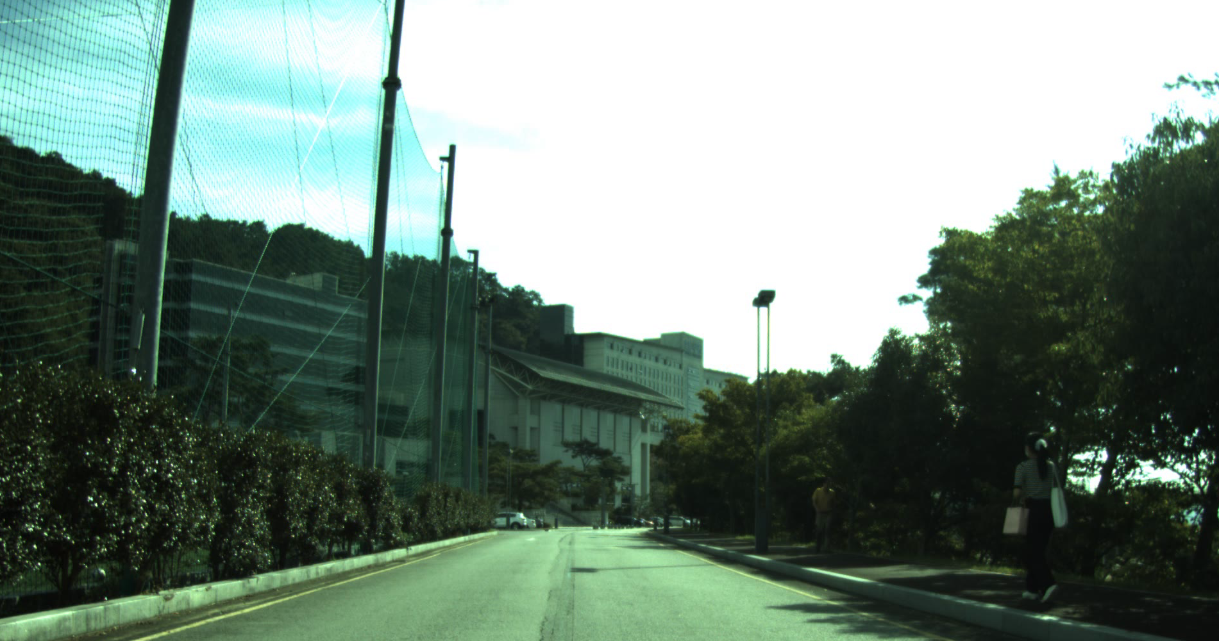
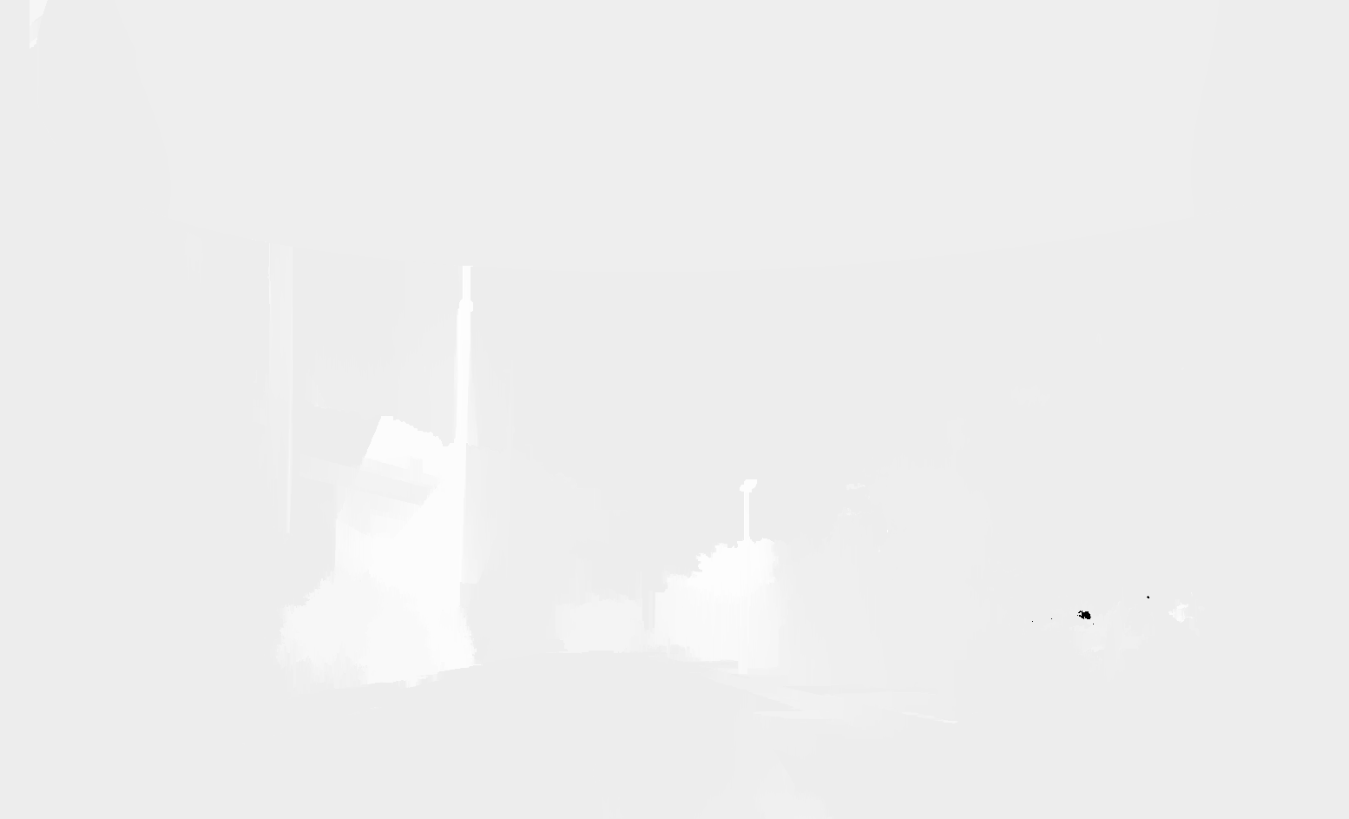
Part 3
Depth Image
Left
Right
Depth

Slide 16
Part 4,
To Do

Slide 17


Part 4
To Do
Different Focus Calibration
Modify Parameters
Real-Time Depth Image
generation

